Slide 1
Model Writer
Work Package 1 - Industrial Use Cases and Requirements
Ersan GÜRDOĞAN (HISBIM)

Slide 2
T1.4 – Industrial Use Cases for Turkish Consortium
UC-TR-01 | Documents of Quality Assurance Department
Version | V1.0.0 dated 15-Nov-2014
Description | To create faster and more accurate the forms that are used in quality control progress and trigger related forms (re-work form triggering, revision needed, approved, rejected etc.)
Actors | Quality Managers, Quality Measurement Specialists, Quality Control Personnel, Quality Auditors, Production Crews
Assumptions | Quality control measurement units are standart Rejected and Approved products forms are standart Quality Certification standarts are always applied
Steps | Products information forms are created according to product information comes from ModelWriter system Products are measured by quality control department authorised personnels according to standarts To decide product is standart or not according to measurement report Product would be sent rejected products section if its measures are out of standarts ModelWriter system is created Rejected Product Quality Form Else Approved Product Quality Form is created by ModelWriter System Approved products are sent to warehouse as accepted products
Alternatives | If rejected products' measurement out of range in rework standarts, it means cannot be applied rework on this product, it returns to scrap. Then it should be sent wasteland.
Issues | Standartising form designs is hard because of all customers have their own unique reporting tools/formats

Slide 3
T1.4 – Industrial Use Cases for Turkish Consortium
UC-TR-02 | Non-Disclosure Agreements
Version | V1.0.0 dated 15-Nov-2014
Description | Non-Disclosure Agreement (NDA), also known as a confidentiality agreement (CA), confidential disclosure agreement (CDA), proprietary information agreement (PIA), or secrecy agreement (SA), is a legal contract between at least two parties that outlines confidential material, knowledge, or information that the parties wish to share with one another for certain purposes, but wish to restrict access to or by third parties. It is a contract through which the parties agree not to disclose information covered by the agreement. An NDA creates a confidential relationship between the parties to protect any type of confidential and proprietary information or trade secrets. As such, an NDA protects nonpublic business information. NDAs are commonly signed when two companies, individuals, or other entities (such as partnerships, societies, etc.) are considering doing business and need to understand the processes used in each other's business for the purpose of evaluating the potential business relationship. NDAs can be "mutual", meaning both parties are restricted in their use of the materials provided, or they can restrict the use of material by a single party. It is also possible for an employee to sign an NDA or NDA-like agreement with an employer. In fact, some employment agreements will include a clause restricting employees' use and dissemination of company-owned confidential information.
Actors | Responsible/Authorised personnel in both parties.
Assumptions | Agreements are prepared and written according to European Business Law.
Steps | To define both partied who would sig the NDA To write items of agreement according to scope of NDA Reviewing agreement by decision maker then getting approval Sharing NDA each other Send feedback to ModelWriter system if any change apply on NDA Sahepen final version of NDA then signing by both parties
Alternatives | After sharing NDA, both parties sign without any change and no feedback imzalanması. Cancellation of NDA
Issues | Different laws could be applied in out of European Union

Slide 4
T1.0 - Evaluation Methods & Tools
Evaluation should show:
1) What actually occurred?
2) Whether it had an impact, expected or unexpected, and
3) What links exist between a program and its observed impacts?
This will result in D1.0.1 Evaluation Methods & Tools

Slide 5
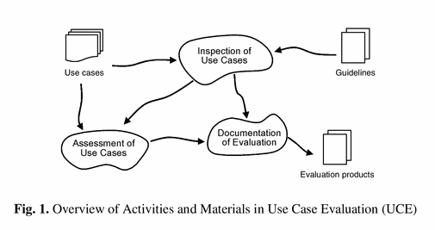
D1.0.1 Evaluation Methods & Tools
Methods & Tools should answer the questions below?
What are we trying to achieve?
Is the role of the group to advise or steer the project?
Who will draft the plan (or protocol)?
Who and how will the data be collected?
Who and how will the data be analysed?
Who will write up the final report?
What is the time frame?
Usability evaluation with the Use Case Evaluation (UCE) method consists of three overall activities, see Fig. 1:

Slide 6
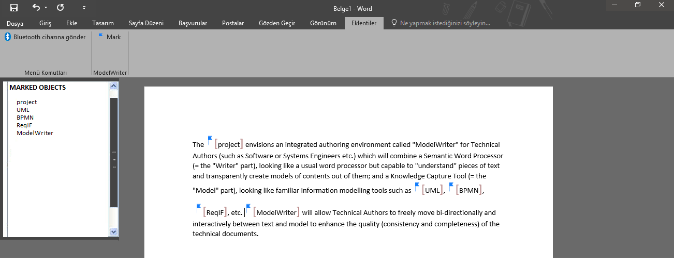
ModelWriter Plug-in for Microsoft Word
2
3
1
1) Written text in main window of Ms-Word
2) Ribbon in upper menu tabs
3) Action Pane on left-hand side

Slide 7
Thank you for your attention! Any question ?

